Slide 1

G2M Case Study
Virtual Internship
20-Jan-2021

Slide 2
Background –G2M(cab industry) case study
XYZ is a private firm in US. Due to remarkable growth in the Cab Industry in last few years and multiple key players in the market, it is planning for an investment in Cab industry and as per their Go-to-Market(G2M) strategy they want to understand the market before taking final decision.
We have been provided with multiple data sets that contains information on 2 cab companies. Each file (data set) provided represents different aspects of the customer profile. XYZ is interested in using your actionable insights to help them identify the right company to make their investment.
Data Set:
You have been provided 4 individual data sets. Time period of data is from 31/01/2016 to 31/12/2018. Below are the list of datasets which are provided for the analysis:
Cab_Data.csv – this file includes details of transaction for 2 cab companies
Customer_ID.csv – this is a mapping table that contains a unique identifier which links the customer’s demographic details.
Transaction_ID.csv – this is a mapping table that contains transaction to customer mapping and payment mode
City.csv – this file contains list of US cities, their population and number of cab users

Slide 3
Data Exploration
19 Features
Timeframe of the data: 2016-01-31 to 2018-12-31
Total data points :359,391
Types of Analysis:
Profit Analysis
Demand Analysis
Customer Analysis
Citywise Analysis
Monthly and Seasonal Analysis
Gender Analysis

Slide 4
Data Exploration
Assumptions for Data Quality Analysis:
Consistency of Unique Identifiers:
Assumed that 'Transaction ID' and 'Customer ID' are consistent and accurately represent unique records.
Verified that these identifiers are not duplicated or misassigned.
Data Integrity:
Assumed that data integrity is maintained, ensuring accurate and consistent values in critical fields such as 'Date of Travel' and 'City.'
Assumption of Accuracy:
Assumed that the provided data accurately reflects the transactions, customer details, and financial information of the cab companies.
Conducted verification of accuracy through cross-referencing with external sources and random sampling checks.
Handling Missing Values:
Assumed that missing values were appropriately handled during data preprocessing.
Identified and addressed any remaining missing values during the analysis.
Assumption of Timeliness:
Assumed that the data reflects the specified time period (from 31/01/2016 to 31/12/2018) with no outliers or discrepancies.
Currency of External Data:
If third-party data (e.g., weather data) was utilized, assumed that it is current and relevant to the time period under analysis.
These assumptions were made in the context of our data quality analysis, and the entire deduplication process has been completed, ensuring the reliability and accuracy of our findings.

Slide 5
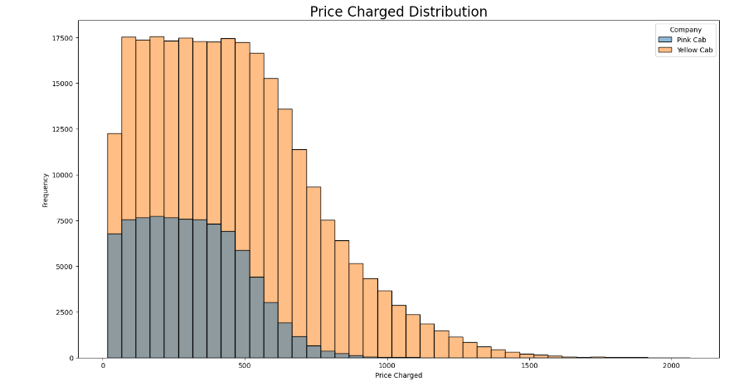
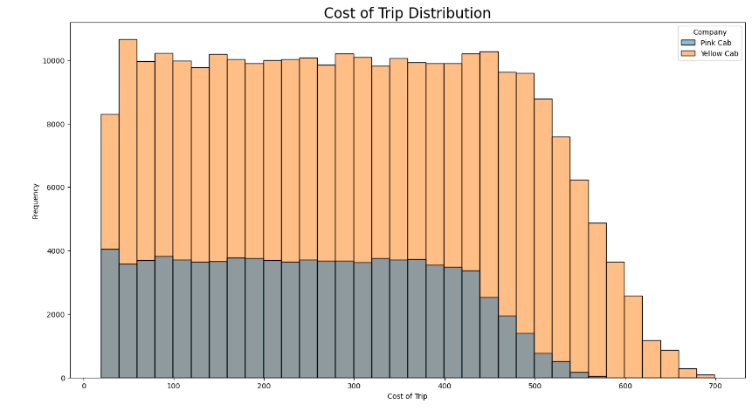
Profit Analysis
Frequency Distribution

Slide 6
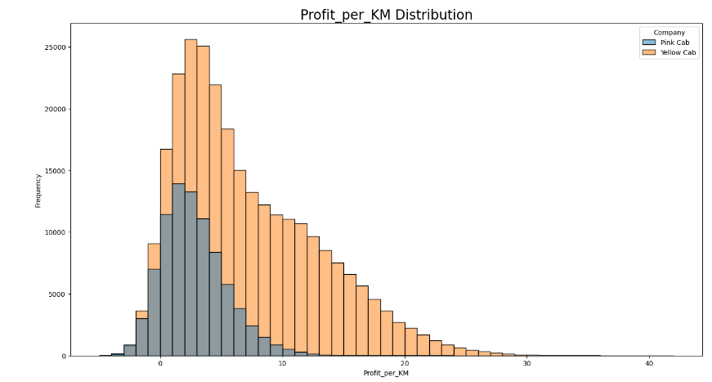
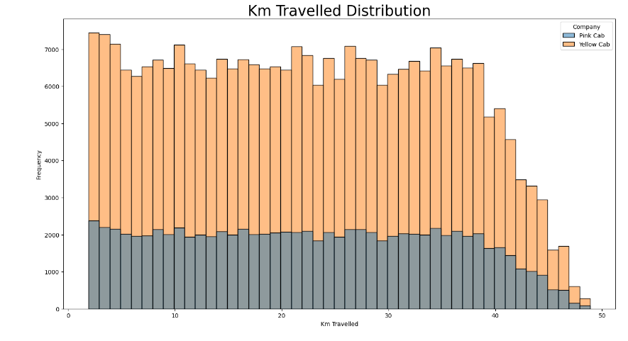

Slide 7
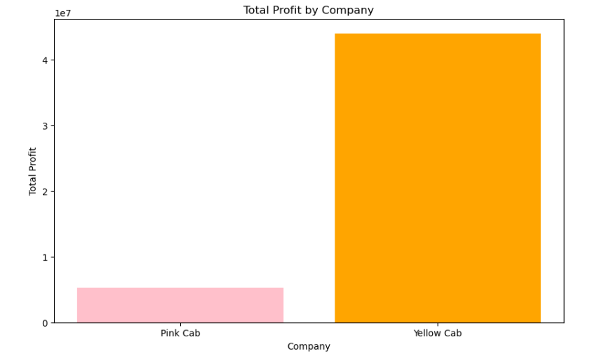
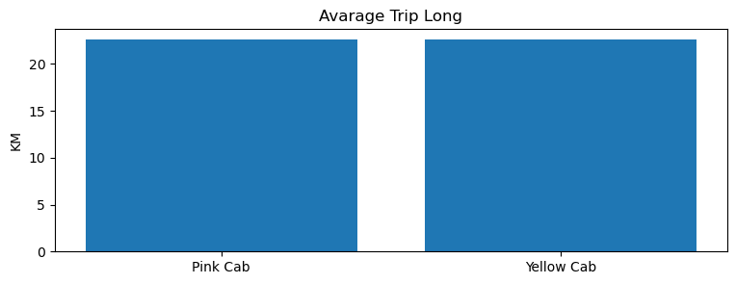

Slide 8
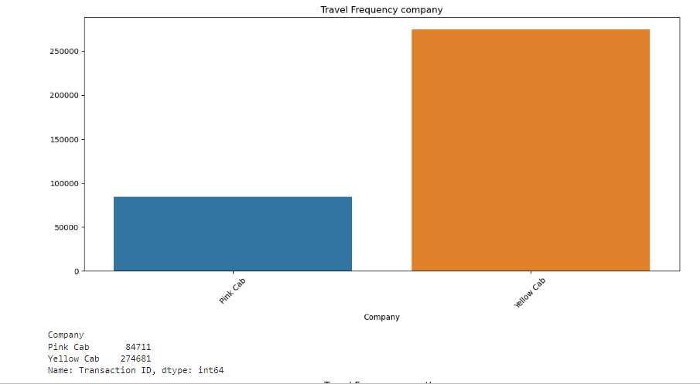

Pink Cab vs Yellow Cab

Slide 9
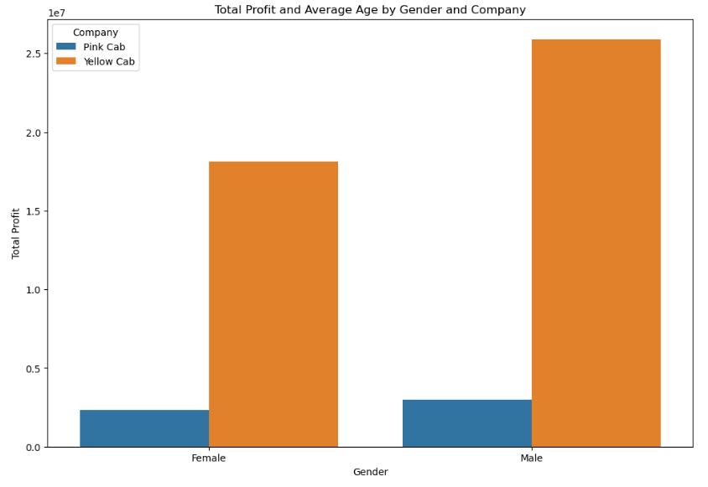
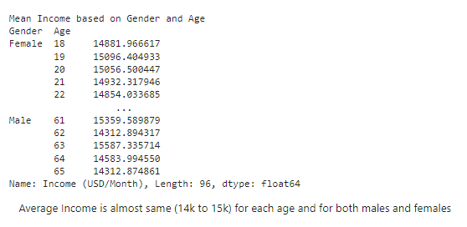

Slide 10
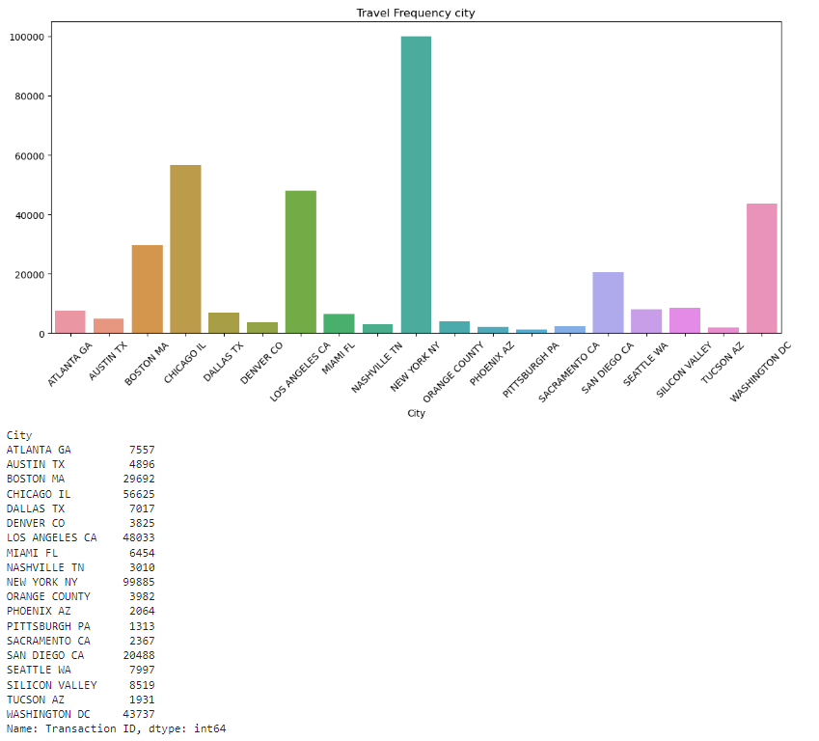
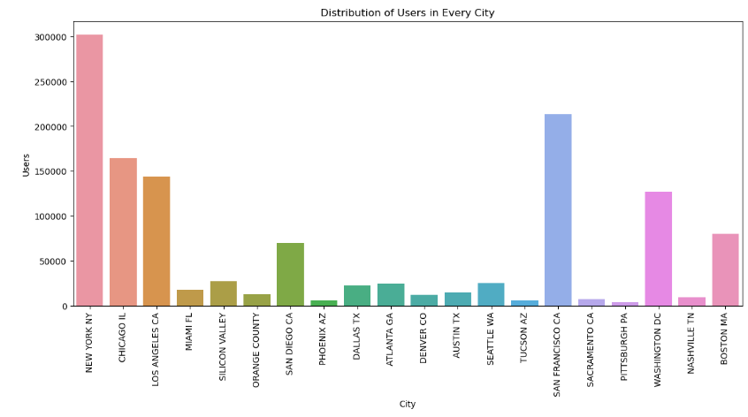
City wise Analysis

Slide 11
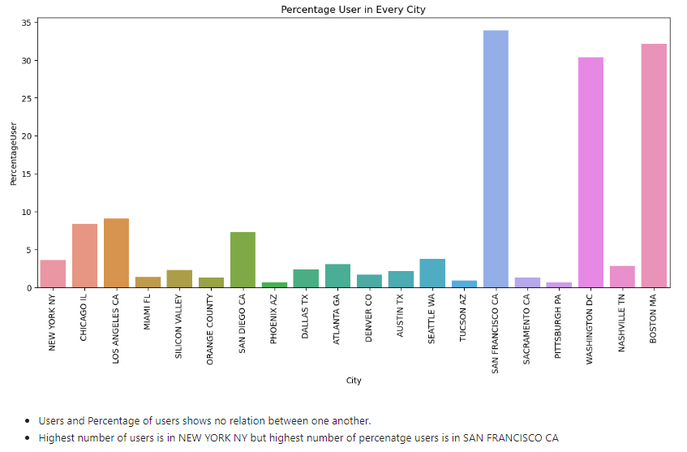

Slide 12
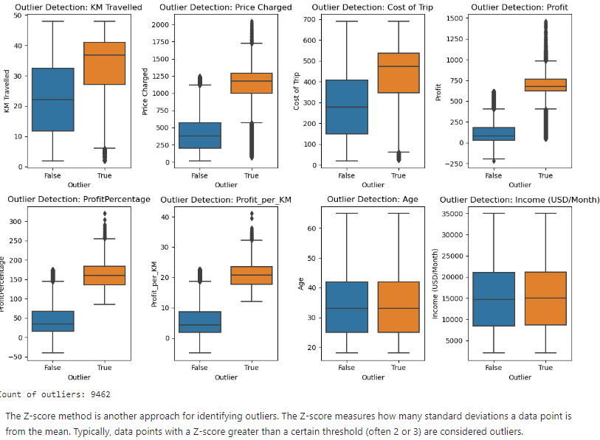
Outlier Analysis using Z-Score

Slide 13
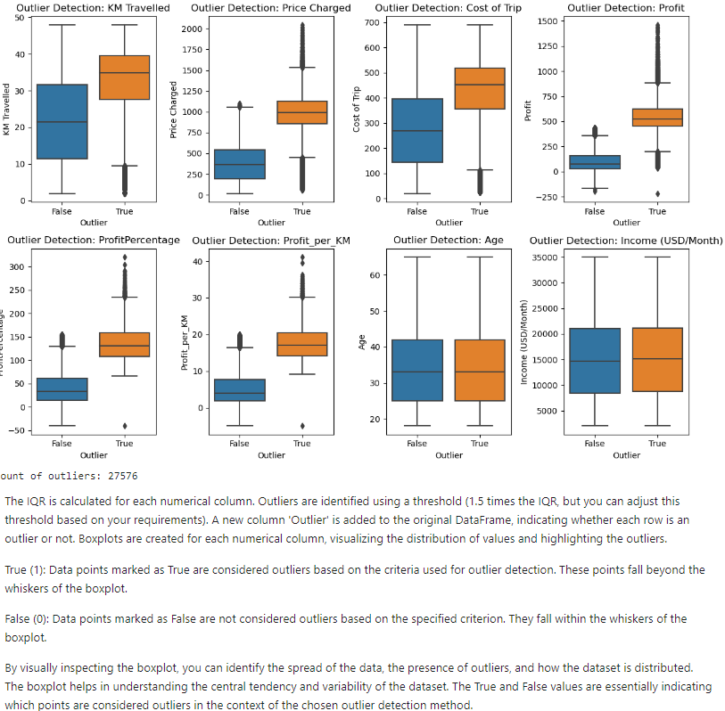
Outlier Analysis using IQR

Slide 14
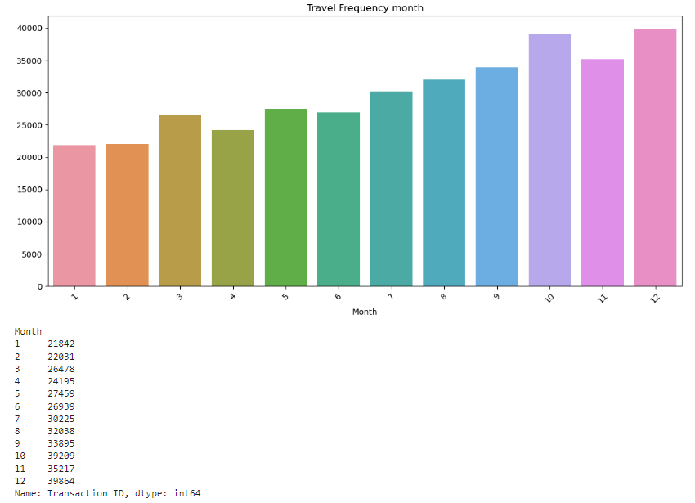
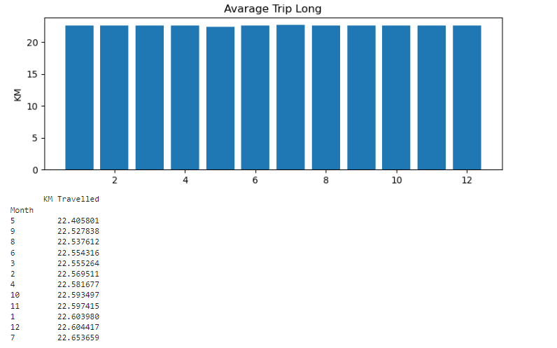
Month wise Analysis

Slide 15
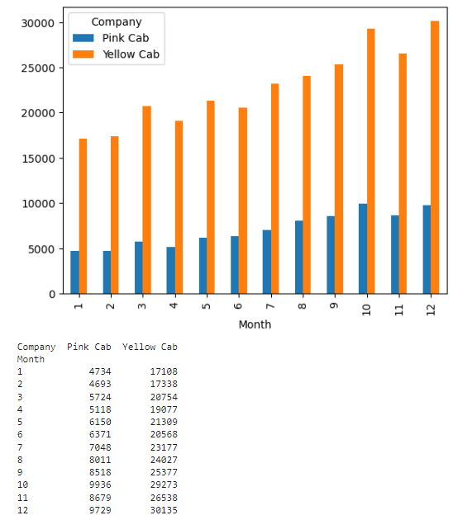
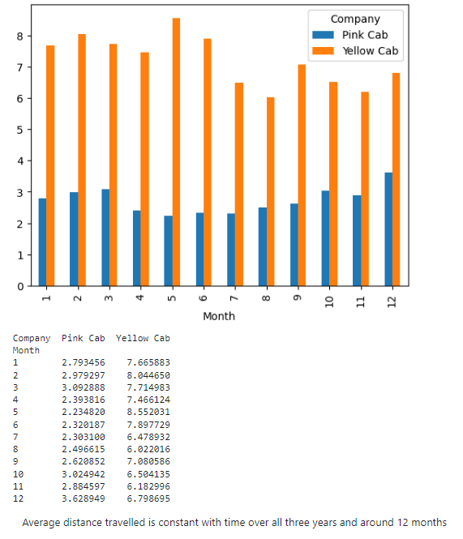

Slide 16
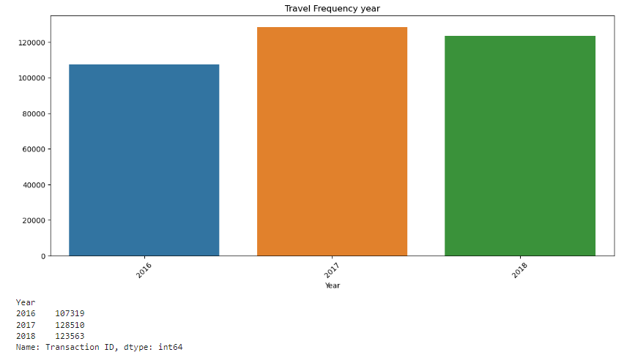
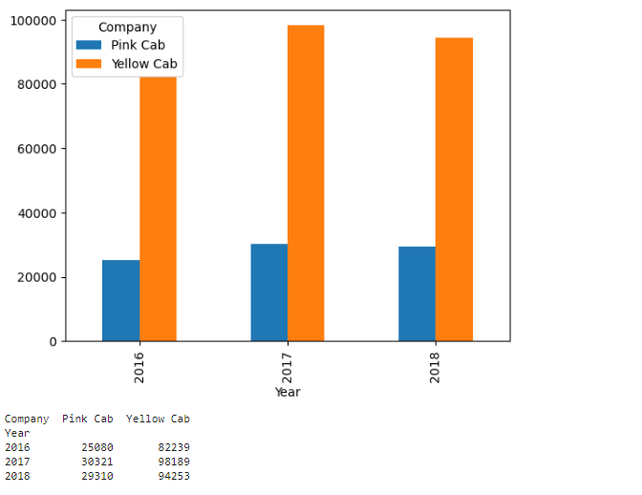
Year wise Analysis

Slide 17
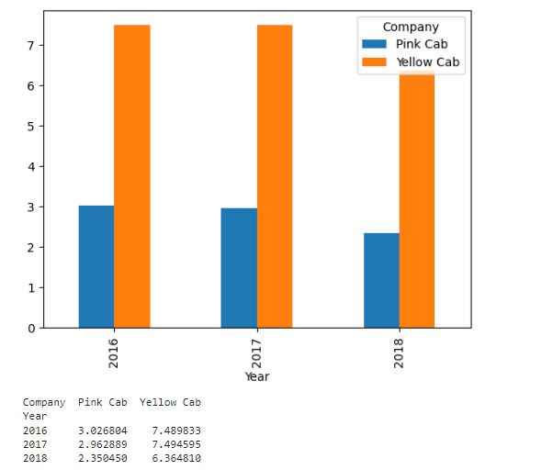
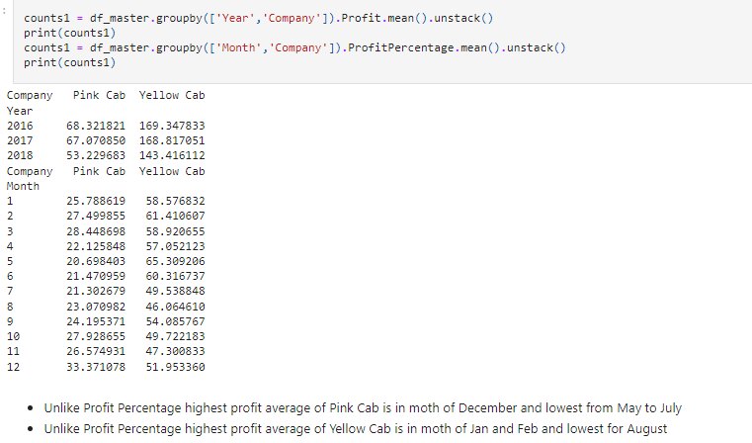

Slide 18
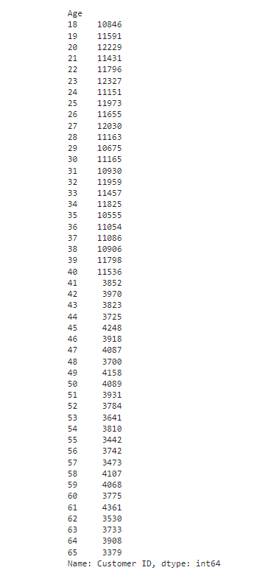
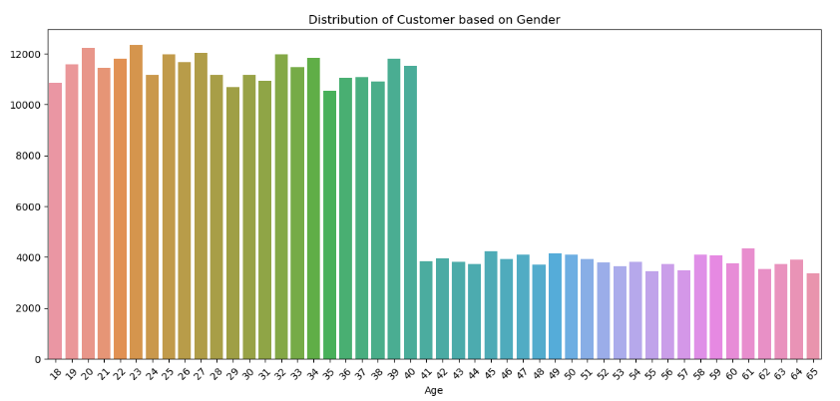
Analysis by user Age

Slide 19
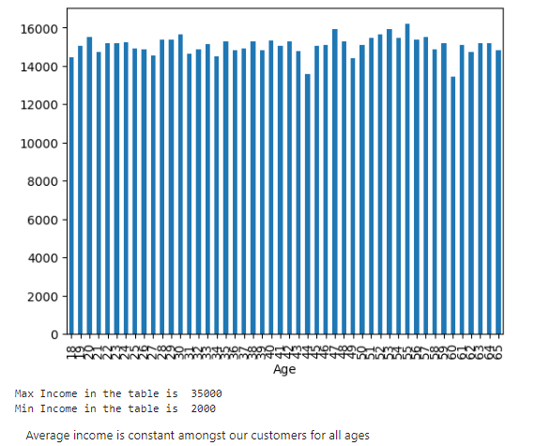
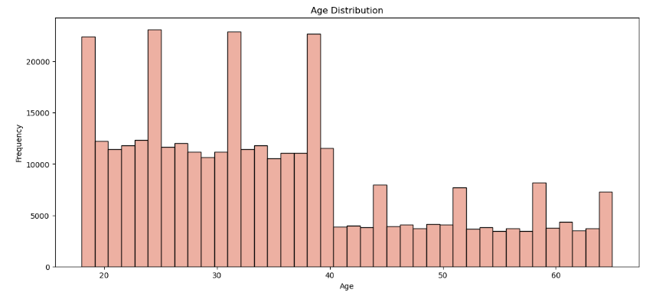

Slide 20
Summary of Business Insights
Profit Analysis: Overall Profitability: Yellow Cab consistently outperforms Pink Cab in terms of profitability. The profit rate of the cab market is approximately 50%, with Yellow Cab showing a higher yearly profit rate (48% - 56%) compared to Pink Cab (21% - 27%). Market Share: Yellow Cab has a significantly larger market share than Pink Cab, contributing to its higher overall profits.
Demand Analysis: Total Demand: Yellow Cab experiences more than triple the demand compared to Pink Cab, indicating a higher level of popularity and usage among customers. Demand Distribution: Both companies show a similar distribution of demand across different age groups.
Customer Analysis: Loyalty Rates: Yellow Cab demonstrates higher loyalty rates among customers, both in terms of high and medium loyalty rates. Payment Mode Distribution: The distribution of payment modes is similar for both companies, with card payments being more popular and profitable.
City-wise Analysis: Yellow Cab has a dominant presence in most cities, except for San Diego, Sacramento, Pittsburgh, and Nashville. The analysis of cities indicates that Yellow Cab is better positioned in terms of market share and profitability.
Monthly and Seasonal Trends: Monthly trends show that the months near the end of the year, particularly December, have the highest profits, likely due to increased holiday travel. Daily trends reveal higher profits on weekends, with occasional spikes on specific days, such as May 1st, 2018, requiring further investigation.
Gender Analysis: While not explicitly stated in the summary, it seems that male passengers contribute more to profits. Further exploration is recommended to understand the factors driving this difference

Slide 21
Reccomendation
Investment Recommendation:
Considering the higher profitability, market share, and demand for Yellow Cab, the top-level recommendation is to invest in Yellow Cab for better growth and return on investment. Future Considerations:
The dataset covers only three years, and the trend in Yellow Cab's profit shows a slight decrease in 2018. Further monitoring and analysis are recommended to assess Yellow Cab's ability to sustain and improve its profit indexes in the future. This summary provides a comprehensive overview of the key business insights derived from the analysis. It highlights the strengths of Yellow Cab in terms of profitability, market share, and customer loyalty, making it a preferable choice for investment.

Slide 22
Thank You

